Slide 1
The Future of Continual Learning in the Era of Foundation Models: Three Key Directions Jack Bell et al. Department of Computer Science, Università di Pisa, 56126 Pisa, Italy

Slide 2
Overview
Do we still need continual learning?
Three pillars of modern continual learning
Continual Pre-Training (CPT)
Continual Fine-Tuning (CFT)
Continual Compositionality and Orchestration (CCO)
The future vision

Slide 3
The Core Question
Foundation models like GPT-4 can handle diverse tasks with internet-scale knowledge
Key question: Do we still need continual learning in this era?
Answer: Yes, Continual learning remains essential for three key reasons
Foundation models are static snapshots that become outdated over time
Real-world deployment requires continuous adaptation to new data and tasks

Slide 4
What is Continual Learning?
Ability to acquire, retain, and refine knowledge over time without forgetting
Two primary goals: Adaptation (rapid responsiveness) and Memory Consolidation (building durable knowledge)
Core challenge: Avoiding catastrophic forgetting (new learning erasing previous knowledge)
Historically evolved from expert systems → reinforcement learning → deep learning approaches
Now essential for foundation models despite their impressive capabilities.

Slide 5
Foundation Model Limitations
Model Staleness: Quickly become outdated as real-world data changes
Economic Burden: Full retraining costs tens of millions of dollars with massive environmental impact
Over-Generalization: Too general for specialized domains or individual user needs
Centralization Risks: Only few organizations can afford to develop and maintain these models

Slide 6
Three Key Directions Overview
Continual Pre-Training (CPT): Incrementally updating foundation models with new data
Continual Fine-Tuning (CFT): Lightweight, task-specific updates for specialization
Continual Compositionality & Orchestration (CCO): Dynamic integration of multiple AI agents
CPT and CFT are important but limited by computational costs and low-frequency updates
CCO is the most promising direction for the future of continual learning

Slide 7
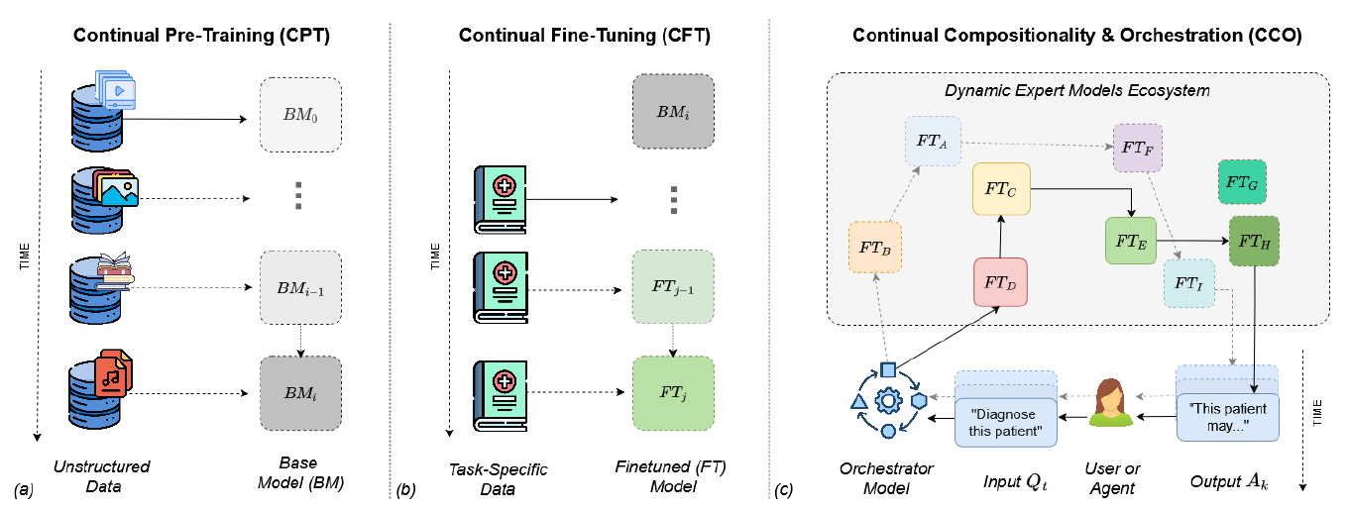
Three Key Directions Overview

Slide 8
1. Continual Pre-Training (CPT)
Purpose: Keep foundation models current by incrementally learning from new data streams
Key Motivations: Dynamic knowledge integration, methodological evolution, resource efficiency, selective forgetting
Major Challenges: Handling catastrophic forgetting, balancing efficiency vs. model drift, avoiding bias reinforcement
Solutions: selective memory/rehearsal methods, self-supervised adaptation techniques
Still early-stage research with long-term stability in real-world deployment under-explored

Slide 9
2. Continual Fine-Tuning (CFT)
Purpose: Transform one-shot adaptation into ongoing capability for specialization
Key Benefits: Personalizes responses, keeps data on-premise, reacts quickly to domain drift, fraction of compute budget
Main Challenges: Balancing specificity vs. generalization, efficient adaptation without catastrophic forgetting, data efficiency and privacy concerns
Solutions: Parameter Efficient Fine-Tuning (PEFT), meta-learning approaches, federated learning strategies
Enables dynamic adaptation to user preferences and domain-specific requirements

Slide 10
3. Continual Compositionality & Orchestration (CCO)
Core Concept: Dynamic integration of multiple AI agents to solve higher-level tasks
Key Motivation: Move beyond monolithic models to collaborative ecosystems
Major Challenges: Task decomposition and specialization, role-based collaboration, error propagation across agents
Solutions: Multi-agent systems, experience accumulation modules, robust communication protocols
Vision: Model-agnostic framework extending beyond language models to diverse AI components

Slide 11
Why CCO is the Future
Current Bottleneck: Diminishing returns from just scaling model size
Test-time Scaling: More "thinking time" often beats bigger models
Multi-agent Success: Specialized models collaborating outperform monolithic approaches
High-frequency Adaptation: Real-world changes need updates in minutes/seconds, not training cycles
Diversity Beats Individual Ability: Random diverse teams often outperform elite individuals

Slide 12
Conclusion & Impact
Continual Learning is Essential: Not optional enhancement but foundational requirement for future AI
CCO as the Key: Academic research should prioritize compositionality over individual model improvements
Democratizing AI: Decentralized ecosystems encourage innovation and reduce barriers to entry
Sustainable Development: Circular economy of AI components rather than wasteful retraining
Next Paradigm Shift: Building resilient, adaptive, context-aware AI systems for real-world challenges

